Slide 1


Movie Genre Classification
Oscar Acero
Nataly Alvarez

Slide 2
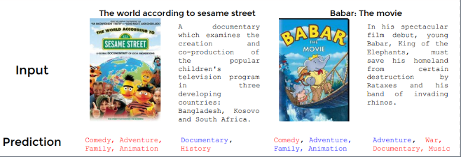
Description
Classify a movie genre based on two inputs:
1.Poster(Image)
2. Poster description

Slide 3

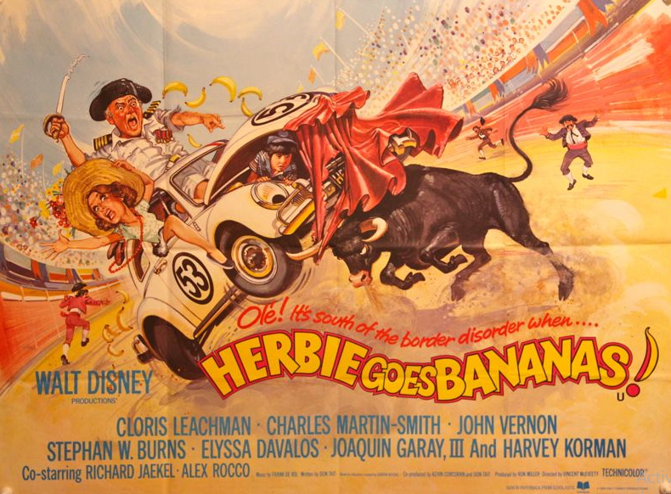
Imagen Model
Steps
Rescale of imagen 244x244
Use Vgg16
Add the VGG16 output as the convolutional base model input
Optimizer: RMSprop

Slide 4
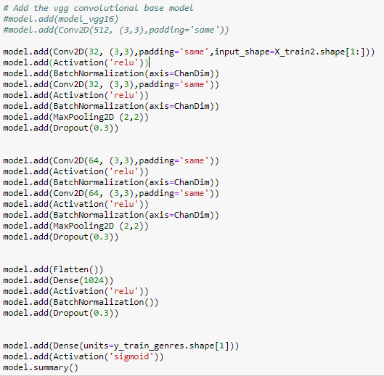
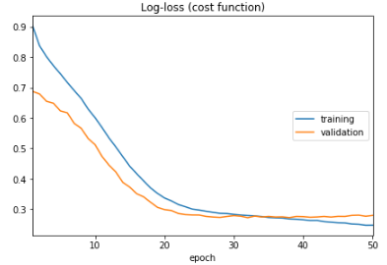
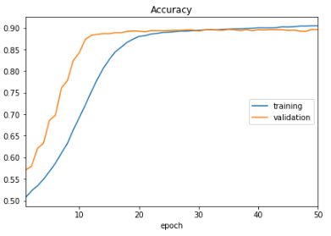

Imagen Model

Slide 5
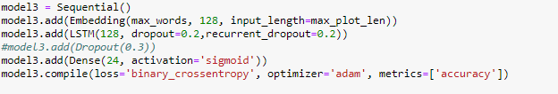
Text Model
Steps
Remove punctuation
Convert words to lower case and split them
Remove stop words
Clean up the text (special characters)
Create embedding

Slide 6
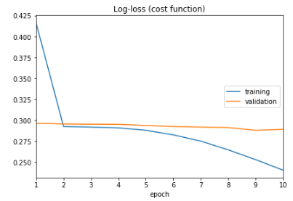
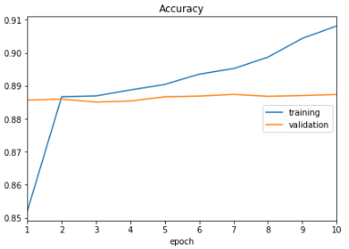


Text Model
Average two Model
Note: The final outcome is the result of averaging the text model’s output and the imagen model’s output

